Slide 1
CSEN20
Fall 2026
Introduction to Embedded Systems
Michael Schimpf, PhD, mschimpf@scu.edu

Slide 2
Chapter 11 Fixed-Point Reals
Part 1: Representation and Arithmetic

Slide 3
Why Fixed-Point Reals?
Many cheap CPU chips designed for embedded applications do not have a FPU.
Software libraries that emulate a FPU can be used but are slow.
Many embedded applications are multi-threaded:
Using a FPU significantly increases the context-switch time.
Preserve S0 – S31

Slide 4
What Are Fixed-Point Reals?
A way to represent a real number using an integer.
Integers imply a binary point at the far right.
Binary point far right: 00101101. → +45₁₀
We can imagine the binary point to be anywhere:
Binary point midway: 0010.1101 → +2.8125₁₀

Slide 5
Q FORMAT AND THE IMAGINARY BINARY POINT
A way to specify the position of the binary point
“Q” followed by the number of bits to the right of the binary point:
Sometimes use Qm.n, where m = # integer bits and n = # fractional bits.
Integer | Q | Implied | Interpretation
+71₁₀ (01000111₂) | Q0 | 01000111. | +71/2⁰ | = | +71.00000₁₀
 | Q3 | 01000.111 | +71/2³ | = | + 8.87500₁₀
−56₁₀ (11001000₂) | Q2 | 110010.00 | −56/2² | = | −14.00000₁₀
 | Q5 | 110.01000 | −56/2⁵ | = | − 1.75000₁₀
Q8.0
Q5.3
Q6.2
Q3.5

Slide 6
ADDITION AND SUBTRACTION OF FIXED-POINT REALS
Easy as long as operands have same Q format
Just use regular integer addition or subtraction:
Operand | Integer | Q | Interpretation
A | +30₁₀ | Q3 | +30/2³ | = | +3.750₁₀
B | −54₁₀ | Q3 | -54/2³ | = | −6.750₁₀
+30/8 = -3.750₁₀
-54/8 = -6.750₁₀
Result | Integer | Q | Interpretation
A+B | −24₁₀ | Q3 | -24/2³ | = | −3.000₁₀
+3.750 + (-)6.750 = -3.000₁₀
A−B | +84₁₀ | Q3 | +84/2³ | = | +10.500₁₀
+3.750 – (-)6.750 = +10.500₁₀

Slide 7
ADDITION AND SUBTRACTION OF FIXED-POINT REALS
Pre-align operands with different Q formats:
Shift the operand with fewer fractional bits left:
Operand | Integer | Q | Interpretation
A | +30₁₀ | Q3 | +30/2³ | = | +3.75₁₀
B | −54₁₀ | Q5 | -54/2⁵ | = | −1.6875₁₀
* 2²
Transform to Q5 format!
Operand | Integer | Q | Interpretation
A | +120₁₀ | Q5 | +120/2⁵ | = | +3.75₁₀
B | −54₁₀ | Q5 | -54/2⁵ | = | −1.6875₁₀
Result | Integer | Q | Interpretation
A+B | +66₁₀ | Q5 | +66/2⁵ | = | +2.0625₁₀

Slide 8
MULTIPLICATION OF FIXED-POINT REALS
Consider what happens when you multiply two decimal reals:
1.53
×2.3
153
×23
459
306
3519
Then the decimal point is inserted so that the number of fractional digits is the sum of those in the two operands.
The digits of the product are determined without regard to the decimal points.
3.519
$$add together the fractional digits 2+1=3$$

Slide 9
MULTIPLICATION OF FIXED-POINT REALS
Add 3 + 2 = Q5
Same as in decimal, but Q format changes
The number of fractional bits in the product is the sum of those in the operands.
Operand | Integer | Q | Interpretation
A | +30₁₀ | Q3 | +30/2³ | = | +3.7500₁₀
B | +51₁₀ | Q2 | +51/2² | = | +12.7500₁₀
Result | Integer | Q | Interpretation
A×B | +1530₁₀ | Q5 | +1530/2⁵ | = | +47.8125₁₀

Slide 10
DIVISION OF FIXED-POINT REALS
Consider what happens when you divide two decimal reals:
 | 971
23 | 22347
 | 207
 | 164
 | 161
 | 37
 | 23
 | 14
2.3 | 22.347
9.71
Then the decimal point is inserted so that the number of fractional digits is the difference between those in the dividend less those in the divisor.
The digits of the quotient are determined without regard to the decimal points.
$$\frac{22.347}{2.3} \frac{Dividend}{Divisor} fractional dividend digits −fractional divisor digits 3 −1=2$$

Slide 11
DIVISION OF FIXED-POINT REALS
SUB 5 - 3 = Q2
Integer division, but Q format changes
The number of fractional bits in the quotient is the number in the dividend less those in the divisor
Operand | Integer | Q | Interpretation
A | +1264₁₀ | Q5 | +1264/2⁵ | = | +39.5000₁₀
B | +83₁₀ | Q3 | +83/2³ | = | +10.3750₁₀
Result | Integer | Q | Interpretation
A÷B | +15₁₀ | Q2 | +15/2² | = | + 3.7500₁₀ (Err: 1.50%)

Slide 12
DIVISION: IMPROVING ACCURACY
Shift dividend left before dividing
Increases Q factor of dividend and thus
Increases Q factor of quotient and thus
Increases number of fractional digits of quotient
Increase precision * 2³
Operand | Integer | Q | Interpretation
A | +1264₁₀ | Q5 | +1264/2⁵ | = | +39.5000₁₀
B | +83₁₀ | Q3 | +83/2³ | = | +10.3750₁₀
Result | Integer | Q | Interpretation
A÷B | +15₁₀ | Q2 | +15/2² | = | +3.7500₁₀ (Err: 1.50%)
2³×A | +10112₁₀ | Q8 | +10112/2⁸ | = | +39.5000₁₀
(2³×A)÷B | +121₁₀ | Q5 | +121/2⁵ | = | + 3.78125₁₀ (Err: 0.682%)

Slide 13
DIVISION: IMPROVING ACCURACY
Increase the magnitude of dividend by half that of the divisor before dividing
Rounds the least-significant bit of quotient
Subtract (don’t add) when dividend is negative
Operand | Integer | Q | Interpretation
2³×A + B/2 | +10153₁₀ | Q8 | +10153/2⁸ | = | +39.5000₁₀
B | +83₁₀ | Q3 | +83/2³ | = | +10.3750₁₀
Result | Integer | Q | Interpretation
(2³×A+B/2)÷B | +122₁₀ | Q5 | +122/2⁵ | = | + 3.81250₁₀ (Err: 0.138%)

Slide 14
Chapter 11 Fixed-Point Reals
Part 2: Q16.16 Format

Slide 15
FIXED-POINT USING A UNIVERSAL Q16.16 FORMAT
Uses the same Q format for all variables
Q16.16 fits in a single 32-bit word
No pre-alignment needed to add or subtract
Product: 64 bits ← 32 bits x 32 bits (SMULL)
Q16.16 result is the middle 32 bits

Slide 16
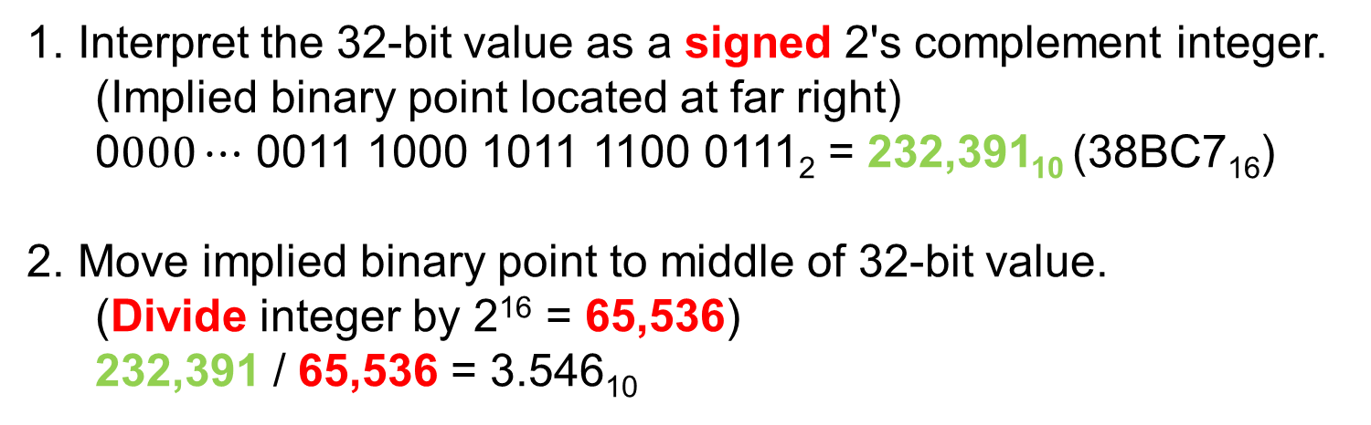
Interpreting a Q16.16 Real
31 |  |  |  |  |  |  |  |  |  |  |  |  |  |  | 16 | 15 |  |  |  |  |  |  |  |  |  |  |  |  |  |  | 0
0 | 0 | 0 | 0 | 0 | 0 | 0 | 0 | 0 | 0 | 0 | 0 | 0 | 0 | 1 | 1 | 1 | 0 | 0 | 0 | 1 | 0 | 1 | 1 | 1 | 1 | 0 | 0 | 0 | 1 | 1 | 1
Implied position of Q16 binary point.
Implied position of integer binary point.
Interpret the 32-bit value as a signed 2's complement integer.
(Implied binary point located at far right)
0$000⋯$ 0011 1000 1011 1100 0111₂ = 232,391₁₀ (38BC7₁₆)
Move implied binary point to middle of 32-bit value.
(Divide integer by 2¹⁶ = 65,536)
232,391 / 65,536 = 3.546₁₀
LSR 16

Slide 17
Converting Q16.16 to float
Visual Studio Example
float Q16ToFloat(Q16 x){
return x / 65536.0; // x >> 16
}
LSR 16
LSR 16
Must be a floating-point constant
NOTE: Not using a FPU, the C run-time library provides a (slow) software emulation. Avoid using this function in any loop or repetitive computation.

Slide 18
Creating a Q16.16 Real Constant
31 |  |  |  |  |  |  |  |  |  |  |  |  |  |  | 16 | 15 |  |  |  |  |  |  |  |  |  |  |  |  |  |  | 0
Implied position of the binary point.
Visual Studio Example
typedef int32_t Q16 ; // NOTE: Container is an integer
Q16 x = 3.7 ; // NO: truncates to integer 3 (not 3.0)
Q16 x = (int32_t) (65536 * 3.7 + 0.5) ; // YES
LSL 16
Multiply by 2¹⁶ so that binary point is in the middle
For rounding (subtract when desired constant is negative)

Slide 19
Converting float to Q16.16
typedef int32_t Q16;
Q16 FloatToQ16(float x){
float rounding;
if (x >= 0.0)
rounding = +0.5;
else
rounding = -0.5;
return (Q16) (65536.0 * x + rounding);
}
LSL 16

Slide 20
Converting float to Q16.16
#define ROUNDFLOAT(x) (((x) >= 0.0) ? +0.5 : -0.5)
#define FLOATTOQ16(x) (65536.0*(x) + ROUNDFLOAT(x))
When x is a constant, use a macro to avoid the computation at run-time
LSL 16

Slide 21
Chapter 11 Fixed-Point Reals
Part 3: Q16.16 Multiplication

Slide 22
Q16.16 × Q16.16 Multiplication
Multiplicand (Q16.16)
31
0
whole part
32-bit integer multiplicand
fractional part
NOTE: Must use signed double-length multiply since result uses part of most-significant half of the product
Multiplier (Q16.16)
31
0
whole part
32-bit integer multiplier
×
fractional part
SMULL
63
48
47
32
31
16
15
0
fractional part
64-bit integer product
discarded
whole part
Integer part
fractional part
Integer part
discarded
Some loss of range
Product (Q16.16)
Some loss of precision

Slide 23


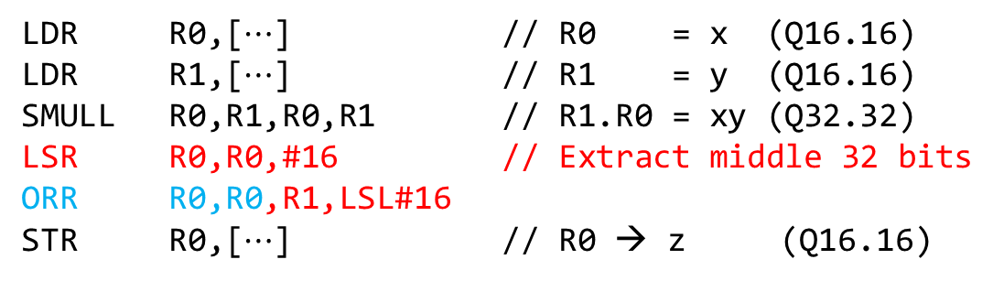


Q16.16 × Q16.16 Multiplication
31 |  |  |  |  |  |  | 16 | 15 |  |  |  |  |  |  | 0
$$x$$
Q16.16 variable $x$ has 16 fractional bits
31 |  |  |  |  |  |  | 16 | 15 |  |  |  |  |  |  | 0
× $y$
Q16.16 variable y has 16 fractional bits
63 |  |  |  |  |  |  | 24 | 23 |  |  |  |  |  |  | 32 | 31 |  |  |  |  |  |  | 16 | 15 |  |  |  |  |  |  | 0
$$xy$$
R 0
R 1
Thus the 64-bit Q32.32 product will have 32 fractional bits
LDR R0,[$⋯$] // R0 = x (Q16.16)
LDR R1,[$⋯$] // R1 = y (Q16.16)
SMULL R0,R1,R0,R1 // R1.R0 = xy (Q32.32)
LSR R0,R0,#16 // Extract middle 32 bits
ORR R0,R0,R1,LSL#16
STR R0,[$⋯$] // R0 → z (Q16.16)
6 instructions,
6 clock cycles

Slide 24
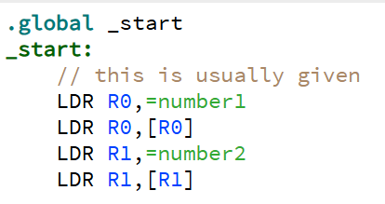
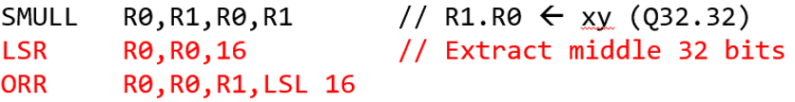
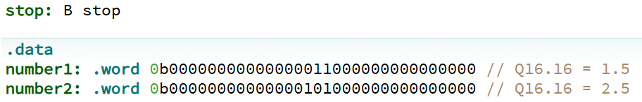
Implement this example with CPUlator
https://cpulator.01xz.net/?sys=arm
CPULator: 01_FixedReal_SMULL.s
Imaginary point
.
.

Slide 25
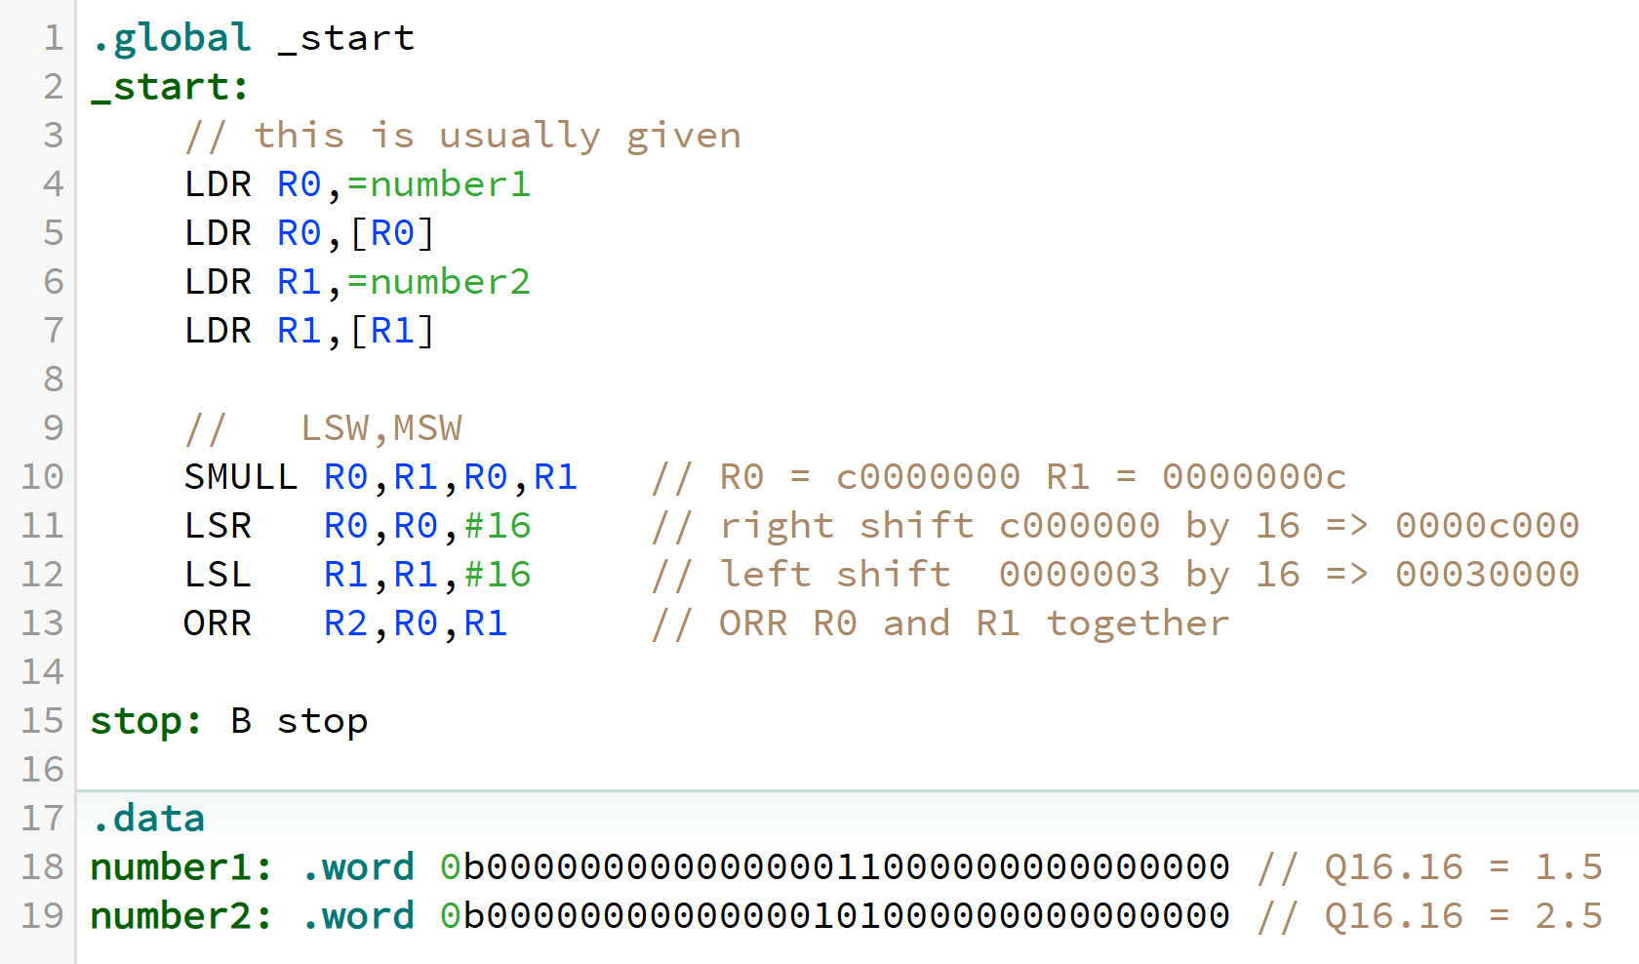
Implement this example with CPUlator
CPULator: 01_FixedReal_SMULL.s
Imaginary point
.
.

Slide 26


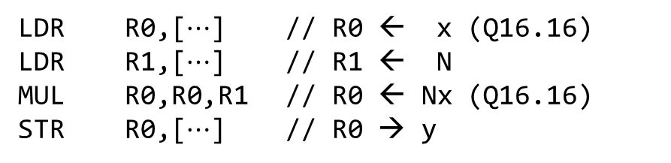


Special Case: Multiplying Q16.16 by an Integer
31 |  |  |  |  |  |  | 16 | 15 |  |  |  |  |  |  | 0
$$x$$
Q16.16 variable $x$ has 16 fractional bits
31 |  |  |  |  |  |  |  |  |  |  |  |  |  |  | 0
× $N$
integer N has 0 fractional bits
63 |  |  |  |  |  |  | 24 | 23 |  |  |  |  |  |  | 32 | 31 |  |  |  |  |  |  | 16 | 15 |  |  |  |  |  |  | 0
$$Nx$$
The 64-bit Q0.32 product will have 16 fractional bits
LDR R0,[$⋯$] // R0 ← x (Q16.16)
LDR R1,[$⋯$] // R1 ← N
MUL R0,R0,R1 // R0 ← Nx (Q16.16)
STR R0,[$⋯$] // R0 → y
4 instructions,
4 clock cycles

Slide 27
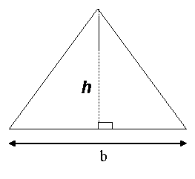
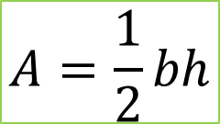
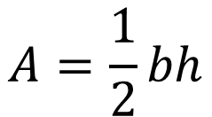
Example: Q16 Area of a Triangle
CPULator: 02_FixedReal_AreaOfTriangle.s
Example:
b = 1.5
h = 2.5
½ * 1.5 * 2.5 =1.875 = 0x1.e
$$A=\frac{1}{2}bh$$
Q16 AreaOfTriangle(Q16 b, Q16 h) ;
AreaOfTriangle:
SMULL R0,R1,R0,R1 // R1.R0 = Q32.32 product b x h
LSR R0,R0,#16 // Extract middle 32 bits
ORR R0,R0,R1,LSL#16
LSR R0,R0,#1 // Divide by 2
BX LR
$$A=\frac{1}{2}bh$$
The second LSR can be eliminated by shifting right by 17 bits instead of 16.

Slide 28
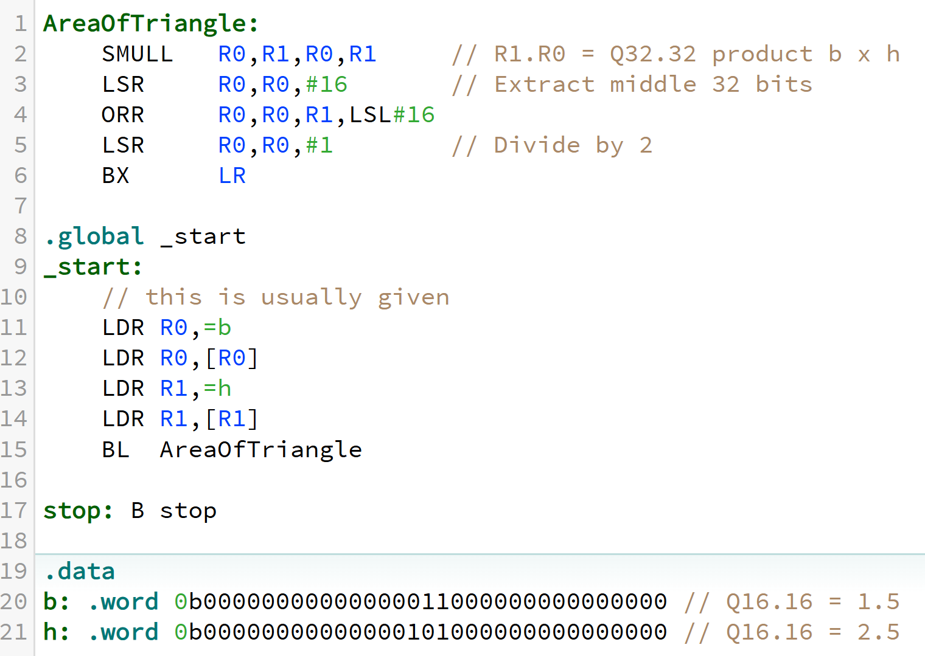
AreaOfTriangle CPUlator
CPULator: 02_FixedReal_AreaOfTriangle.s

Slide 29



Ex: Q16 Volume of a Sphere
CPULator: 03_FixedReal_VolumeOfSphere.s
$$V= \frac{4}{3}πr^{3}$$
Q16 VolumeOfSphere(Q16 r) ;
VolumeOfSphere:
SMULL R1,R2,R0,R0 // R2.R1 = Q32.32 product r squared
LSR R1,R1,#16 // Extract Q16.16 product into R1
ORR R1,R1,R2,LSL#16
SMULL R0,R1,R1,R0 // R1.R0 = Q32.32 product r cubed
LSR R0,R0,#16 // Extract Q16.16 product into R0
ORR R0,R0,R1,LSL#16
LDR R1,=274516 // R1 = (4*pi)/3 x 65536 = 274,516.5548…
SMULL R0,R1,R0,R1 // R1.R0 = Q32.32 volume
LSR R0,R0,#16 // Extract Q16.16 product into R0
ORR R0,R0,R1,LSL#16
BX LR
$$V= \frac{4}{3}πr^{3}$$
$$V= \frac{4}{3}πr^{3}$$
Example: (4 * pi) / 3 = 4.188790205 * (1.25 * 1.25 * 1.25) = 8.181230469
1000 . 0010 1110 0110 0100
8 . 2 e 6 4

Slide 30
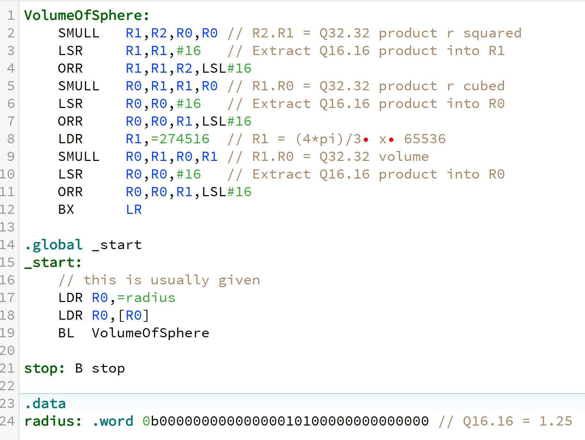
VolumeOfSphere CPUlator
CPULator: 03_FixedReal_VolumeOfSphere.s

Slide 31
Done

